Slide 1
Purdue University Block & Bridle
1.26.2016

Slide 2
Meeting Dates & Activities
Jan 26- Smith 108 – Coordinate spring semester committees
Feb 9 – Volunteer at Food Finders
Feb 23– Smith 108 – Swine speaker (VFD)
March 9– Smith 108 – Brad & Lindsey Hanewich **
March 30– Smith 108 – Steer/sheep fitting contest @ ASREC **
April 13 – Smith 108 – Officer Election
April 20– Smith 108 – Spring Banquet
All meetings have a 6:30PM start time

Slide 3
Semester Events
Feb 20 – ANSC 181 Club Day
March 4 – Jr. Pork Day
March 31 – April 2 – National Convention
April 1 – Judging Workout
April 4 – Tot’s Day
April 2-7 Purdue Ag Week
April 8/9 – Spring Fest
April 12 – Officer Applications Due
April 20 – Banquet
May 7 – Hog Show

Slide 4
Skip – A – Meal @ Potbelly’s
February 1 from 5PM – 8PM
117 Northwestern Ave
West Lafayette
across from Panda Express!

Slide 5
T-Shirt Designs
Its time to design our club t-shirts!
Email designs to purdueblockandbridle@gmail.com
Earn points for submitting a design!

Slide 6
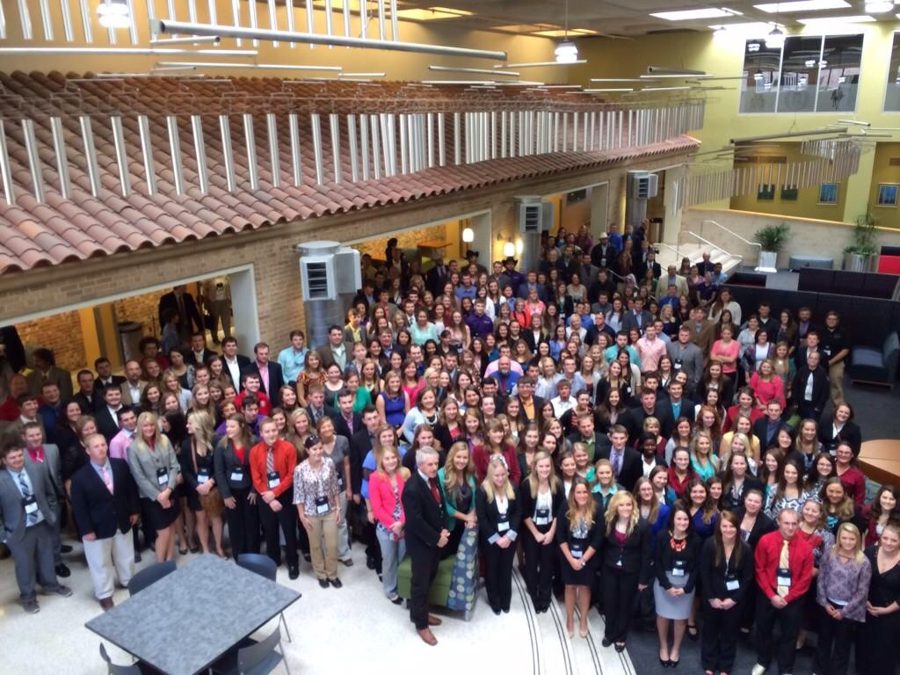

Slide 7
National Convention Details

Slide 8
Paying for National Convention
40+ points = 35% discount, $162.50
30-39.5 points = 30% discount, $175
20-29.5 points = 20% discount, $200
10-19.5 points = 10% discount, $225
Below 10 points = no discount

Slide 9
Paying for National Convention

Slide 10
Committee Breakout Session
Judging Workout Committee
Jr. Pork Day/Hog Show Committee
Ag Week Committee/SpringFest Committee
Tot’s Day

Slide 11
See you next time…
February 9 @ Food Finders, Lafayette!
5:30PM – 7:30PM
1210 N. 10th Street
Lafayette, IN

