Slide 1
Purdue University Block & Bridle

Slide 2
Welcome…
Thank you to everyone who helped out at Food Finders
Club T-shirts
National Convention Updates
If you are a new member, please see Jen or Morgan M.
Block & Bridle Snapchat

Slide 5
1st Annual Block & Bridle Steer & Sheep Fitting Contest
Thursday March 30 @ ASREC
Teams comprised of 2 advanced and 2 novice members
Animals will be show livestock from Oklahoma Youth Expo

Slide 6
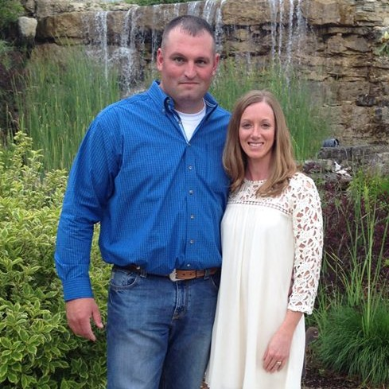
Club Philanthropy Event
Taking Cancer by the Horns
Purdue Challenge 5K
Saturday April 8

Slide 7
2017 Spring Banquet
Thursday, April 20 @ the Beck Center
6:00PM
Catered meal, club awards, industry speaker

Slide 8
Tonight’s Speaker
Dr. Miller, DVM
Four Star Veterinarian Service, Stoney Creek Veterinary Service and Consulation

