Slide 1
Purdue University Block & Bridle

Slide 2
Welcome…
Club T-shirts
National Convention Updates
If you are a new member, please see Jen or Morgan M.

Slide 3
Committee Breakouts and Reports
Break out into your respective committees for 5-10 minutes….
- Hog Show
- Judging Workout
- SpringFest/Ag Week
- Tot’s Day
Have 1 person be prepared to give a 1 minute group update to the club

Slide 5
Add Block & Bridle on Snapchat!

Slide 6
1st Annual Block & Bridle Steer & Sheep Fitting Contest
Thursday March 30 @ ASREC
Teams comprised of 2 advanced and 2 novice members
Animals will be show livestock from Oklahoma Youth Expo

Slide 7
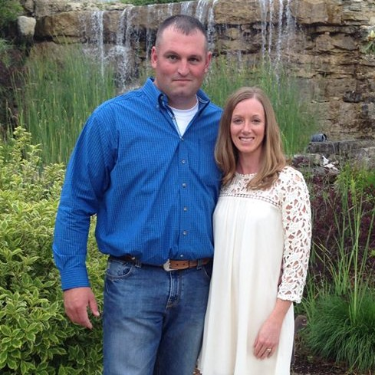
Club Philanthropy Event
Taking Cancer by the Horns
Purdue Challenge 5K
Saturday April 8

Slide 8
2017 Spring Banquet
Thursday, April 20 @ the Beck Center
6:00PM
Catered meal, club awards, industry speaker

Slide 9
Tonight’s Speaker

